Slide 1
APP DEVELOPMENT

Slide 2
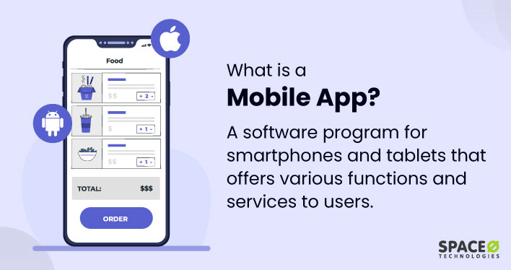

Slide 3




Slide 4
Which of the following tasks can be performed on apps?
A) shopping
B) tickets booking
C) Billing
D) all of these

